Slide 1
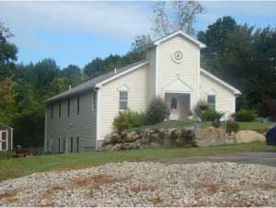


Christian Believers Fellowship
32 Chapel Lane Somersworth, NH
Sunday Worship
Tuesday Bible Study
10:30AM – 12:00PM
6:30PM – 7:30PM

